Slide 1

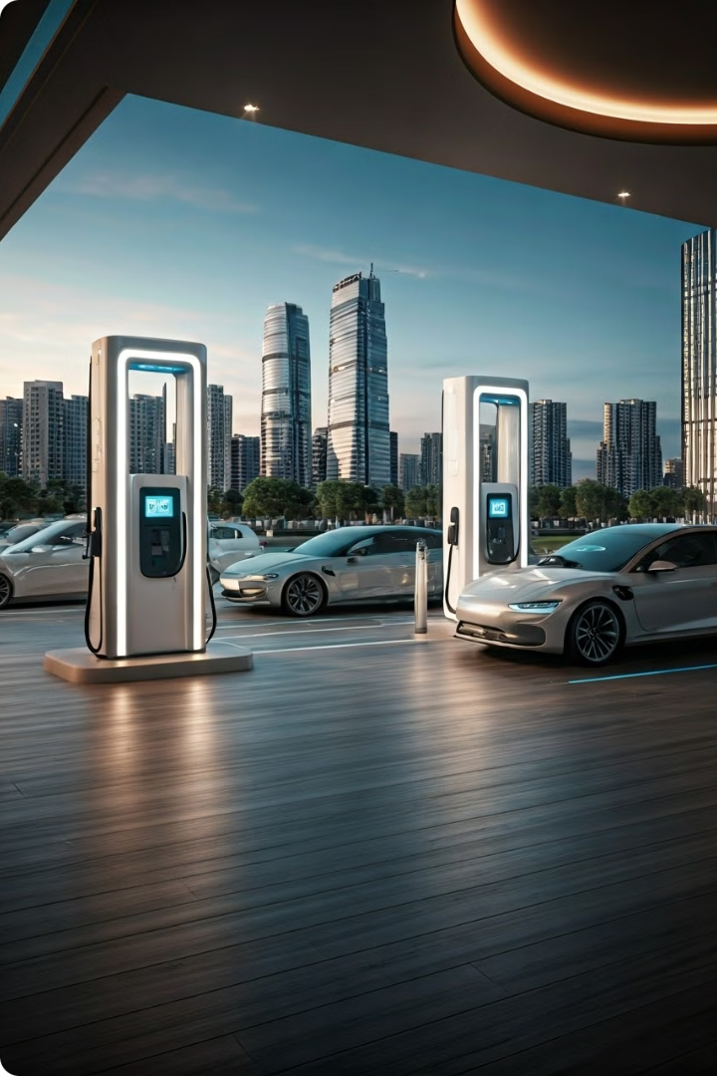
Capstone Project: EV Sales Prediction
This project aims to predict electric vehicle sales and optimize charging infrastructure. It utilizes data from the DOE and DOT to create a predictive model for forecasting EV sales and identifying optimal locations for new charging stations across U.S. states.

Slide 2

Project Overview
1
Demand for EVs
Addresses increasing demand for electric vehicles and the need for efficient infrastructure.
2
Predictive Modeling
Uses DOE and DOT data to create a predictive model for EV sales.
3
Infrastructure Planning
Aims to identify optimal locations for new charging stations across U.S. states.
4
Business Impact
Results assist businesses in the EV industry and inform infrastructure development strategies.

Slide 3
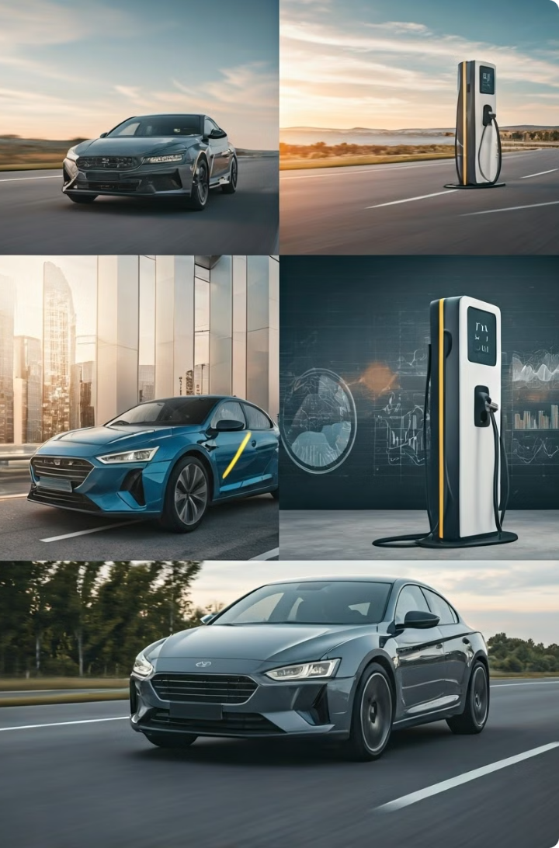




Key Concepts
Electric Vehicles
The main subject of the study, focusing on sales prediction.
Infrastructure Planning
Critical for supporting the growing EV market across states.
Predictive Model
Analytical approach used to forecast sales and plan charging stations.
Charging Stations
Key infrastructure components for supporting electric vehicles.

Slide 4

Methodology
1
Data Collection
Gathered datasets from DOE and DOT, including EV sales and charging station locations.
2
Data Preprocessing
Cleaned and merged datasets to ensure consistency and accuracy for analysis.
3
Predictive Modeling
Used regression analysis to forecast EV sales based on historical data.
4
Clustering Analysis
Applied algorithms to identify optimal locations for new charging stations.

Slide 5
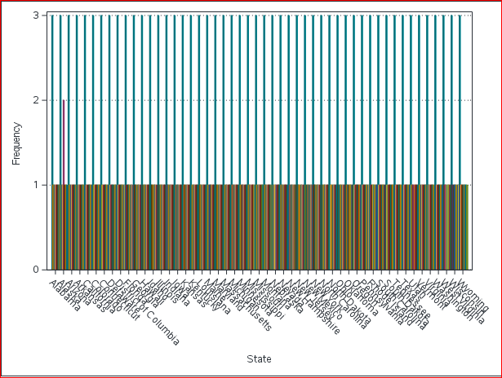
Sales Prediction Analysis

Slide 6
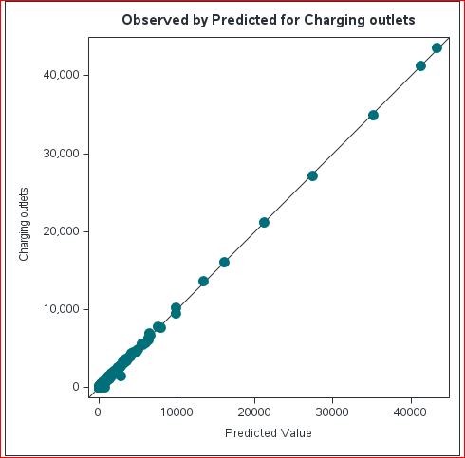
Optimization of Charging Outlets

Slide 7

Charging Infrastructure Analysis
Highest Outlets
Lowest Outlets
Infrastructure Gaps
California leads with the highest number of charging outlets, supporting its high EV adoption rate.
North Dakota and Wyoming have the fewest charging outlets, indicating potential areas for infrastructure development.
Analysis helps identify gaps and opportunities for strategic charging station placement across states.

Slide 8

Key Findings
Sales Prediction Utility
Optimized Infrastructure
Effective prediction of EV sales assists in planning and infrastructure development across states.
Strategic placement of charging stations supports the growing EV market efficiently.
Business Insights
Policy Implications
The model provides valuable data for businesses to make informed decisions in the EV industry.
Findings can guide policymakers in developing supportive infrastructure and market strategies for EVs.

Slide 9





Conclusion and Next Steps
Refine Model
Continuously update and improve the predictive model with new data.
Expand Analysis
Extend the study to include more variables and geographical areas.
Implement Findings
Work with businesses and policymakers to apply insights in real-world scenarios.
Monitor Impact
Track the effectiveness of predictions and infrastructure optimizations over time.

